Slide 1

Social Analytics Assignment
Students:
Rosalia Moffa - ros.moffa@stud.uniroma3.it
Giulia Orlandi - giu.orlandi2@stud.uniroma3.it
Federico Innocenti - fed.innocenti1@stud.uniroma3.it
Daniele Cinque - dan.cinque@stud.uniroma3.it

Slide 2
Assignment Introduction
In this assignment we would like to compare different Ml model in NLP – Sentiment Analysis Task,
In particular we would like to compare 3 main classes of Model:
- Naive Bayes
- Random Forest
- Pre-trained model like Hugging Face – «BERT»

Slide 3
Data Preparation
We import the data of «Amazon Review» and we perform 3 data cleaning process; in particular:
- emoji removal
- special charaters removal
- stopwards removal
We create a Data Frame for each process in order to test how the algorithms perform in different data cleaned Dataset.

Slide 4
Data Preparation 2
As second phase we perform 2 elaboration for reduce the word
to the «roots»:
- Stemming
- Lemmatization

Slide 5
Modelling Analysis
Here we study and compare the different Ml model

Slide 6
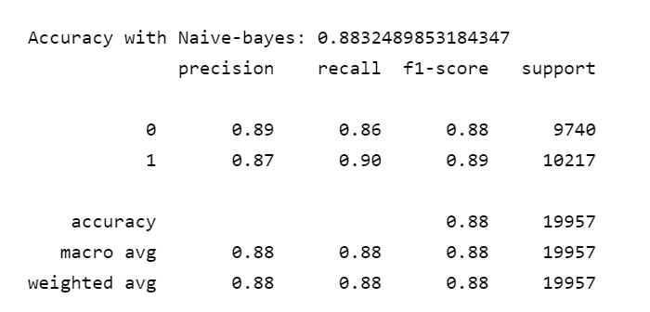
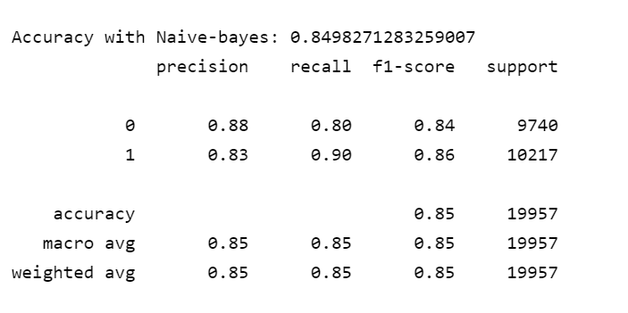
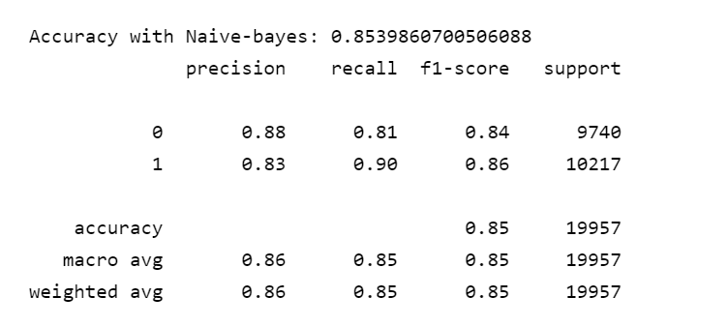
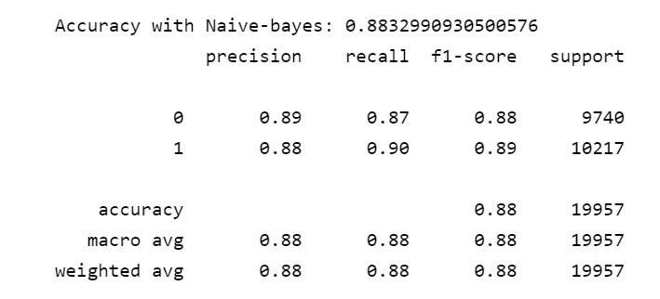
Naive Bayes Model - Multinomial
Emoji removal and Special characters
Stemmed
Emoji removal and Special characters,Stopwords removal
Lemmatized

Slide 7
Naive Bayes Model - Multinomial
As we see the better results are gained from the simple dataset Emoji removal and special character removal (0.88 of accuracy );
the other best results is from Lemmatized dataset (0.88 of accuracy)
That could happen because in the process of cleaning maybe is removed some important part of the phrase that help to distinguish the meaning.
For the next model we will use the following two dataset for comparison.

Slide 8
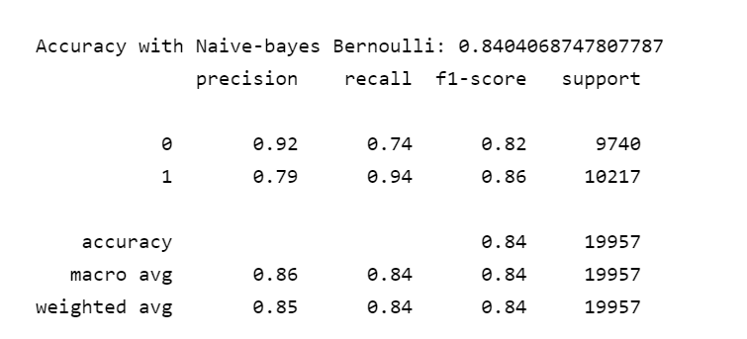
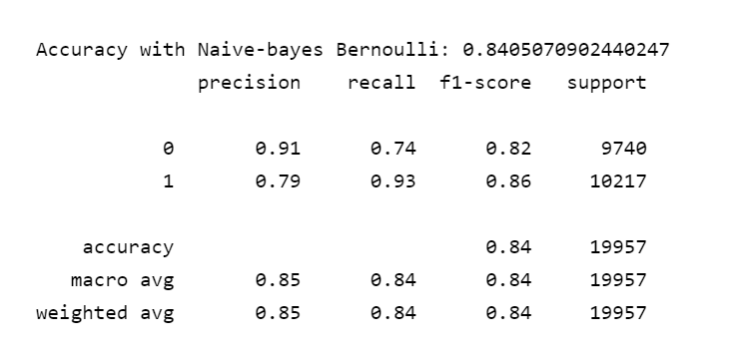
Naive Bayes Model – Bernoulli
Processed Tweets with
Enoji removal and Special characters And Stopwords removal
Processed Tweets with
Enoji removal and Special characters And Stopwords removal
And Lemmatized

Slide 9
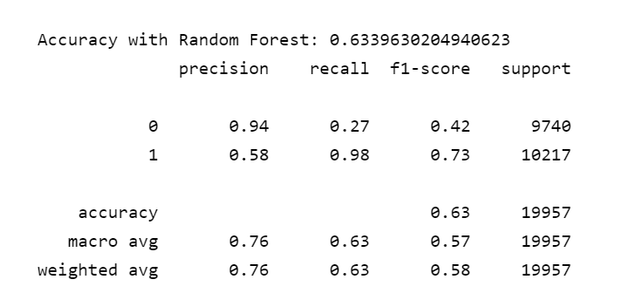
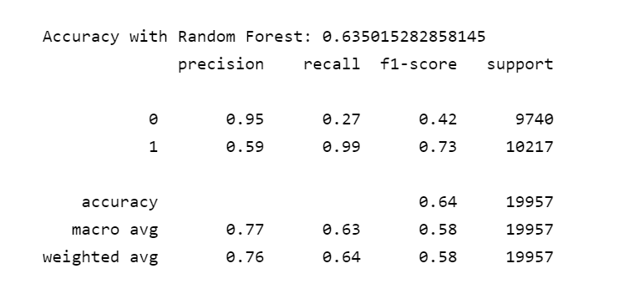
Random Forest
Processed Tweets with
Enoji removal and Special characters And Stopwords removal
Processed Tweets with
Enoji removal and Special characters And Stopwords removal
And Lemmatized

Slide 10
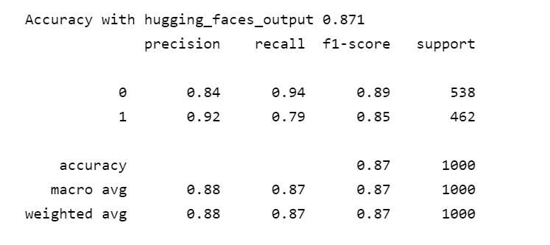
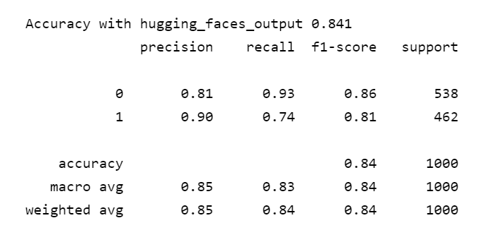
Hugging Face - Bert
Processed Tweets with
Enoji removal and Special characters And Stopwords removal
Processed Tweets with
Enoji removal and Special characters And Stopwords removal
And Lemmatized

Slide 11
Summarization Table
Model | Datasets | Base Cleaned | Lemmatized Dataset
Naive Bayes Multinomial |  | 0.8832 | 0.8833
Naive Bayes Bernoulli |  | 0.8404 | 0.8405
Random Forest |  | 0.6339 | 0.6350
Hugging Faces |  | 0.871 | 0.841
All the model perform really well, except for «Random Forest».
The model tested score more than 80% of accuracy with great results both on precision and recall.
Only Random forest perform lower than 0.70;
By the way we need to say that one reason is due to computational limit, infact we had to try it with a low depth of the tree due to time constrain.
From this analysis the better model on test set seems to be
- Naive Bayes Myltinomial on Lemmatized Dataset.

Slide 12
Thanks For the attention!

